Slide 1

Database Management with MySQL
Introduction
What is Database:
A database is a collection of data stored in a format that can be easily assessed and managed.
A database therefore can easily be assessed and managed by a Data Base Management System (DBMS)
Types of DBMS:
There are basically two types of DBMS; Relational & Non-Relational(NOSQL) DBMS
Relational DBMS manages data that are link together using relationship with the help of a language called SQL( Structured Query Language).
The NONSQL doesn’t understand SQL
SQL: Structured Query Language
SEQUEL: Structured English Query Language
Types of RDBMS: MySQL, SQL Server, Oracle etc.

Slide 2
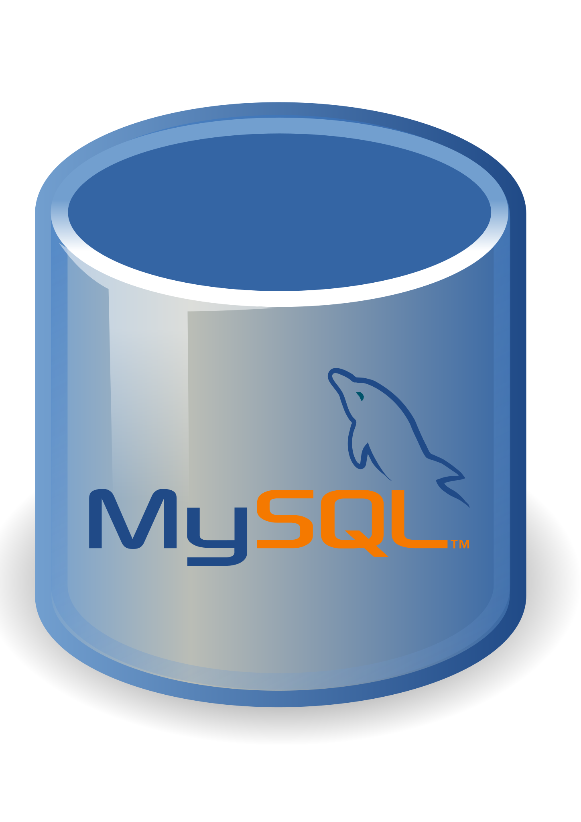

Thanks for the purchase.
For questions kindly reach me on:
awesome8emmanuel@gmail.com
Awesome Emmanuel
Data Analyst/Administrator
Database Management with MySQL

